Slide 1


Troubleshooting SDN Control Software with Minimal Causal Sequences
Colin Scott, Andreas Wundsam, Barath Raghavan, Andrew Or, Jefferson Lai, Eugene Huang, Zhi Liu, Ahmed El-Hassany, Sam Whitlock, Hrishikesh B. Acharya, Kyriakos Zarifis, Scott Shenker
Notes:
Quick intro to SDN: this is a tech talk tomorrow at a startup that’s going to be adopting our system. They’re actually building production controllers, so the expectation is that they know this stuff. To anyone here who doesn’t know it: 15 second intro to SDN.
You’re welcome to interrupt me throughout

Slide 2
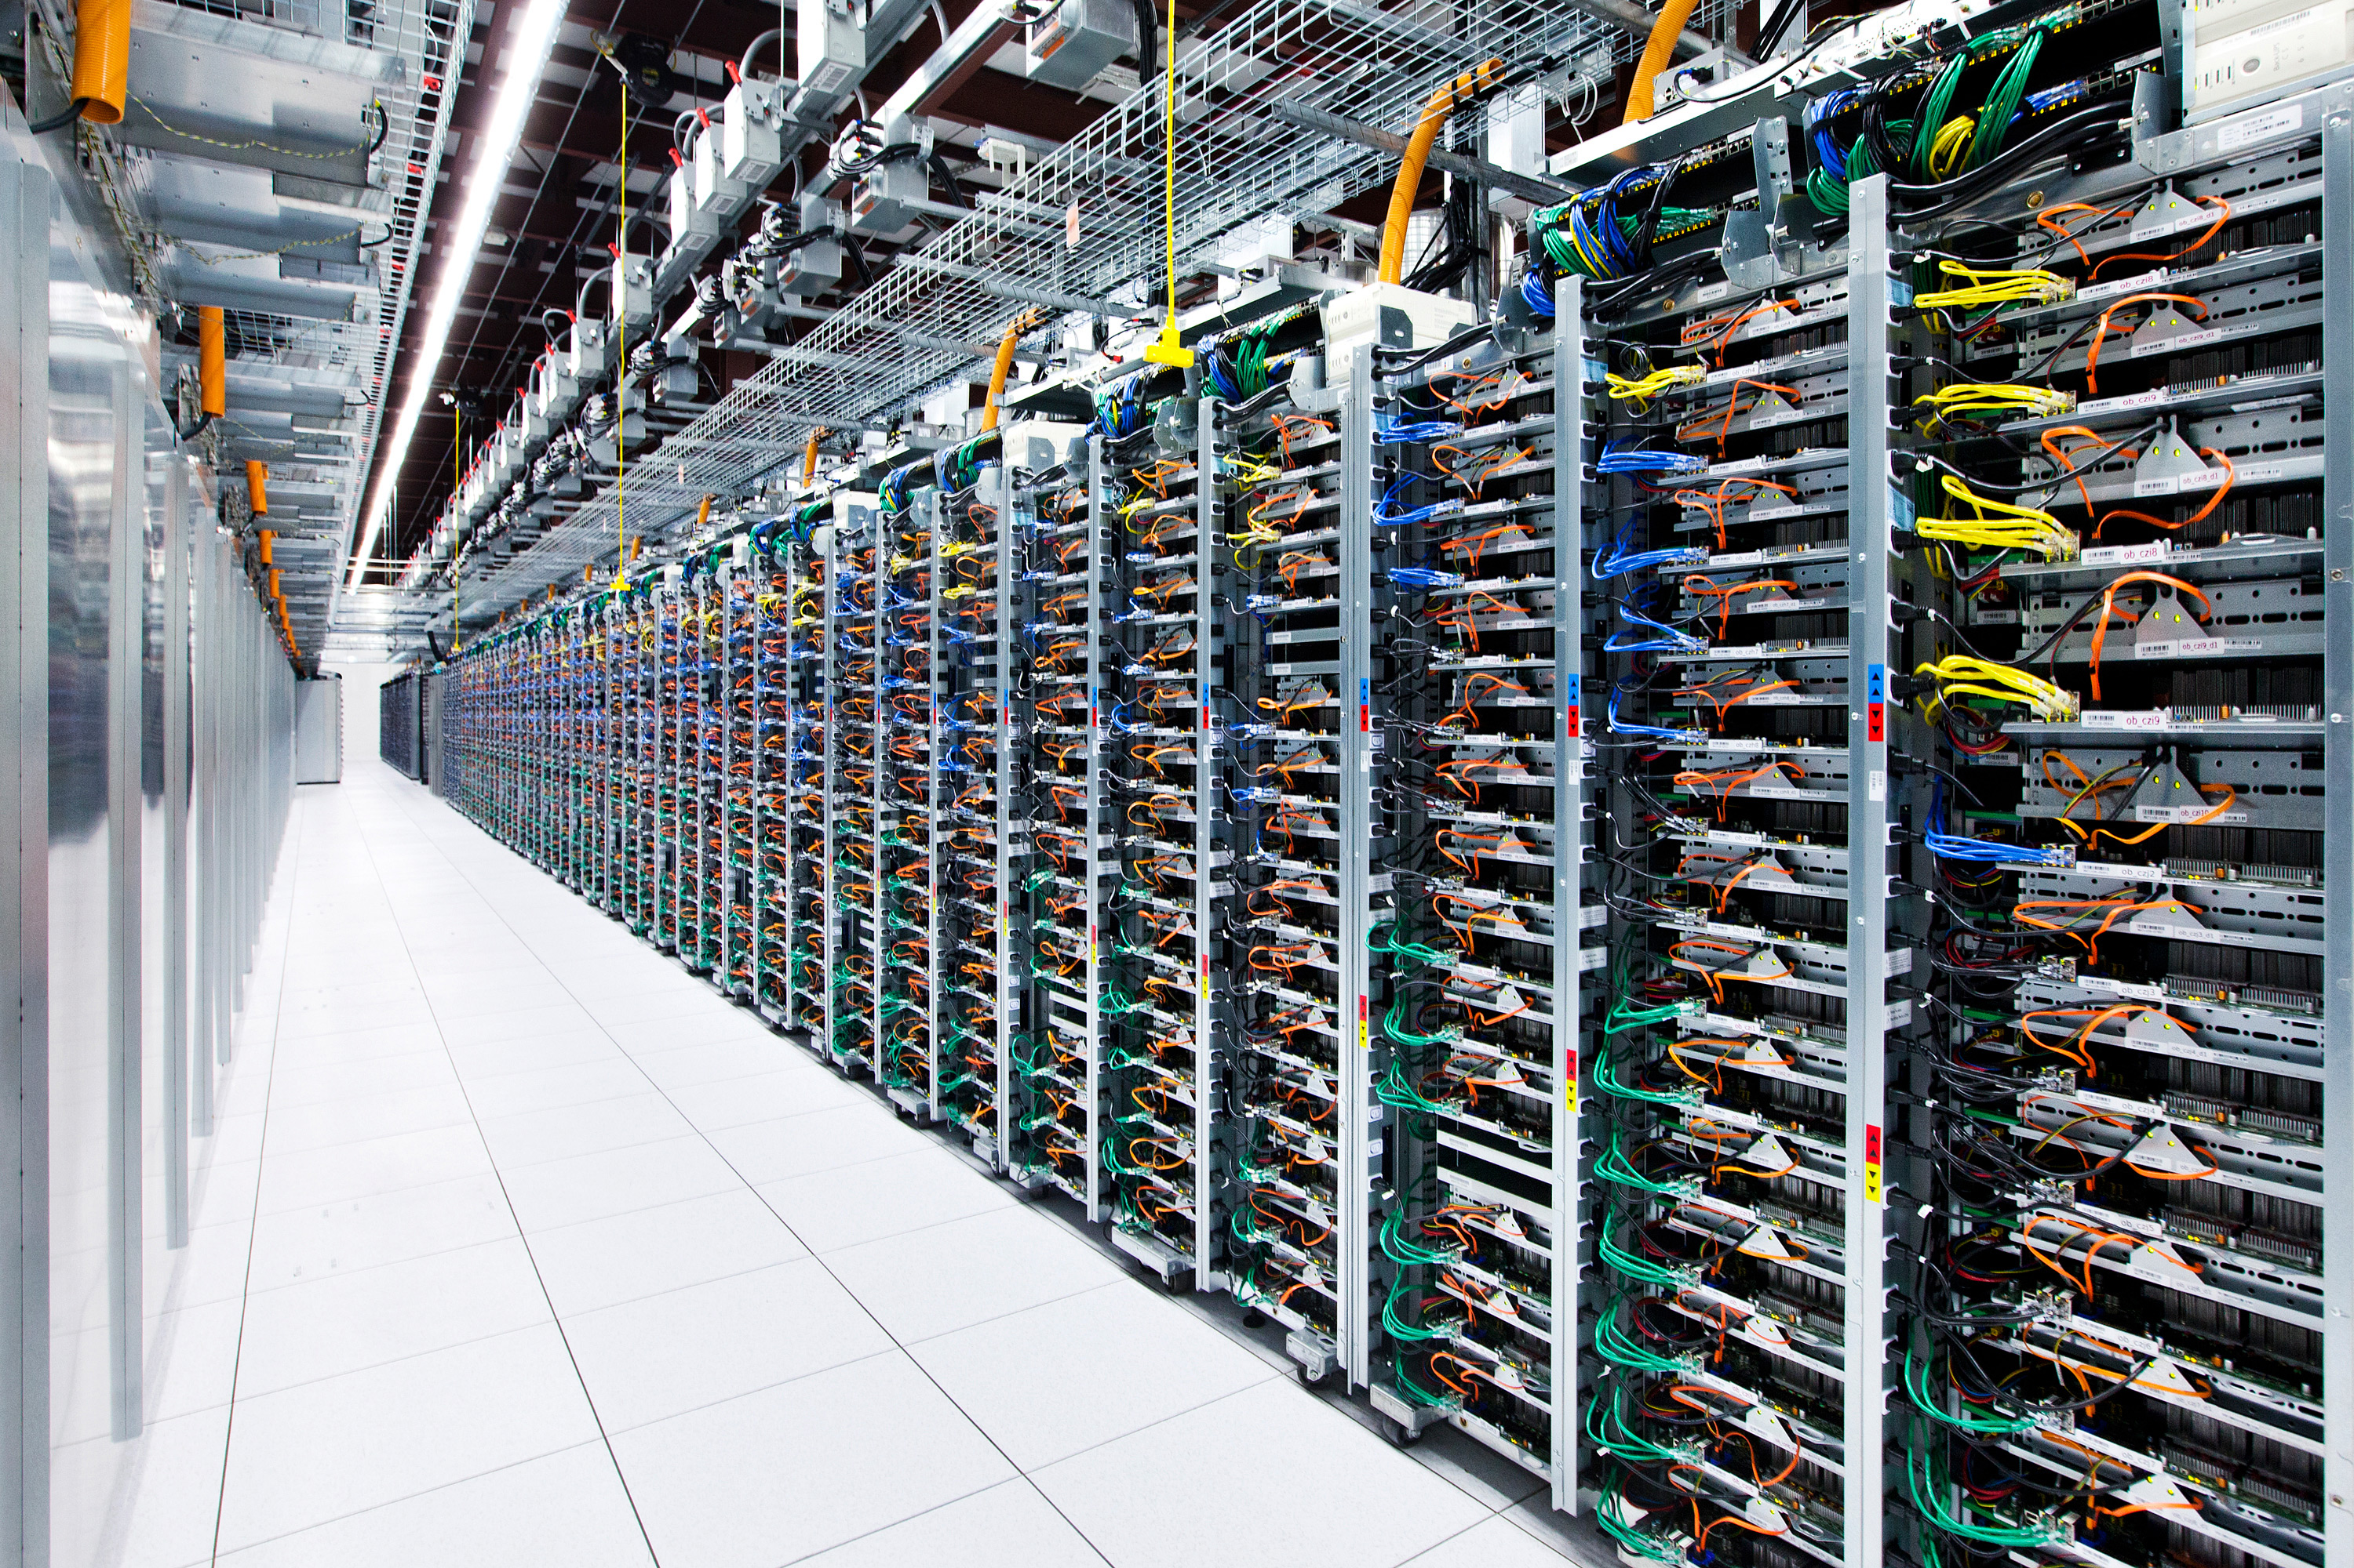

Slide 3

Something goes wrong!
Notes:
Describe what kinds of bugs these might be: loop, blackhole, breach of tenant isolation.

Slide 4
Best practice: Logs
Human analysis of log files
Notes:
From what I saw at Nicira and Google, the most common way to troubleshoot these problems is for a human to analyze log files.

Slide 5
Best practice: Logs
?
Controller A
Switch 1
Switch 2
Switch3
Controller B
Switch 4
Switch 5
Switch 6
Controller C
Switch 7
Switch 8
Switch 9

Slide 6

How many events?
20,000 servers * 4 VMs / server = 80,000 VMs
(6 migrations / day / VM) +
(2 power up|down / day / VM) *
80,000 VMs = 640,000 VM events / day
~= 450 VM changes / minute [1]
8.5 network error events / minute [2]
1 policy change / tenant / day *
2000 tenants ~= 1 policy change / minute

Slide 7
How many events?
= ~500 inputs / minute

Slide 8
Our Goal
Identify a minimal sequence of inputs that triggers the bug

Slide 9
Minimal Causal Sequence

Slide 10
Minimal Causal Sequence
Crash
Master
Ping
Pong
Ping
Backup
Master
Notify
Notify
ACK
Blackhole persists!
Switch
Link Failure
Notes:
Is Rob Vaterlaus in the room?

Slide 11
Minimal Causal Sequence
Master
Ping
Pong
Backup
New Routing Table!
Link Down!
Blackhole resolved!
Switch
Link Failure

Slide 12
Minimal Causal Sequence
Master
Crash
Ping
Pong
Ping
…
Backup
Master
Blackhole avoided!
Switch

Slide 13
Minimal Causal Sequence
Both are necessary conditions!
Master
Crash
Ping
Pong
Ping
Backup
Master
Notify
Notify
ACK
Blackhole persists!
Switch
Link Failure

Slide 14
Minimal Causal Sequence
?
Controller A
Switch 1
Switch 2
Switch3
Controller B
Switch 4
Switch 5
Switch 6
Controller C
Switch 7
Switch 8
Switch 9
Notes:
OK, so how are we going to get from here…

Slide 15
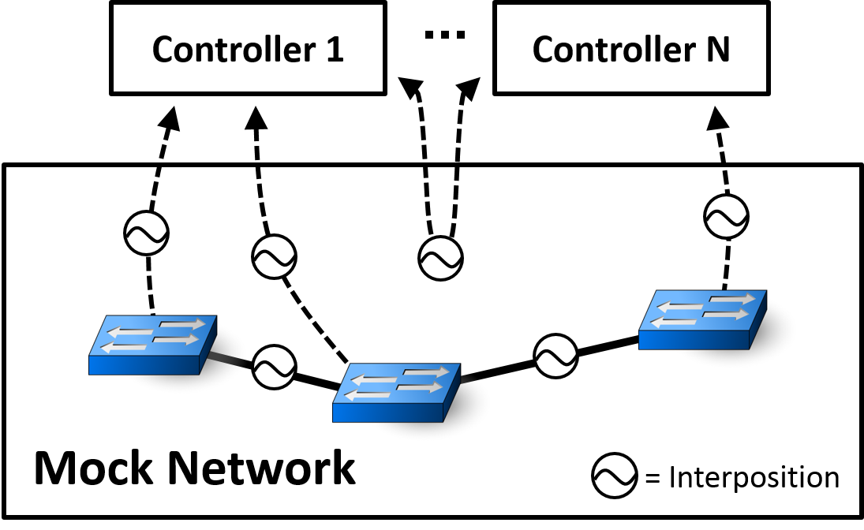
Approach: Interpose on Testbed
Notes:
Need a way to (i) generate fuzz tests, and (ii) replay the resultant system executions.
Two use cases for this: in our evaluation we actually used this simulator to drive testing. Randomly generate input traces, detect bugs using Peyman’s HSA tool, then minimize the traces.

Slide 16
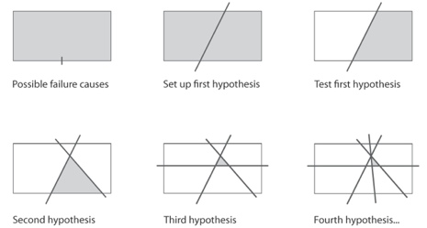
Approach: Delta Debugging
Modify history!
Notes:
If any of you are aware of the work, this technique is called delta debugging.
We let headerspace analysis do the bug detection for us: loops, blackholes, etc.
I should emphasize that, other than discovering this literature, this is not the contribution of this work. Instead, its.. Next slide.
Right now the cuts we make are based on time. But you could imagine doing this slicing based on nodes in the topology, or combinations of types of events.

Slide 17
Replaying Pruned Inputs is Hard
Must consider internal events
Crash
Master
Ping
Seq=3
Pong
Seq=4
Ping
Seq=5
Timeout
Backup
Master
port_status
Xid=12
port_status
xid=13
ACK
Blackhole persists!
Switch
Link Failure
Timeout

Slide 18
Replaying Pruned Inputs is Hard
Must consider internal events
Crash
Master
Ping
Seq=3
Pong
Seq=4
Ping
Seq=5
Timeout
Backup
New Routing Table!
Master
port_status
Xid=12
Blackhole resolved!
Switch
Link Failure

Slide 19
Pruning Alters Internal Events!
Prune Earlier Input..
Crash
Master
Ping
Seq=3
Pong
Seq=4
Ping
Seq=5
Timeout
Backup
Master
port_status
xid=12
port_status
xid=13
ACK
Blackhole persists!
Switch
Link Failure
Timeout

Slide 20
Pruning Alters Internal Events!
Sequence Numbers Differ!
Crash
Master
Ping
Seq=2
Pong
Seq=3
Ping
Seq=4
Timeout
Backup
Master
port_status
xid=11
port_status
xid=12
ACK
Blackhole persists!
Switch
Link Failure
Timeout

Slide 21
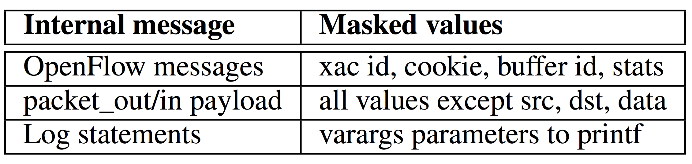
Solution: Equivalence Classes
Mask Over Extraneous Fields

Slide 22
Pruning Alters Internal Events!
Prune Earlier Input..
Crash
Master
Ping
Pong
Ping
Backup
Master
Notify
Notify
ACK
Blackhole persists!
Switch
Link Failure
Notes:
Is Rob Vaterlaus in the room?

Slide 23
Pruning Alters Internal Events!
Some Events No Longer Appear
Crash
Master
Ping
Backup
Master
Notify
Notify
ACK
Blackhole persists!
Switch
Link Failure
Notes:
Is Rob Vaterlaus in the room?

Slide 24
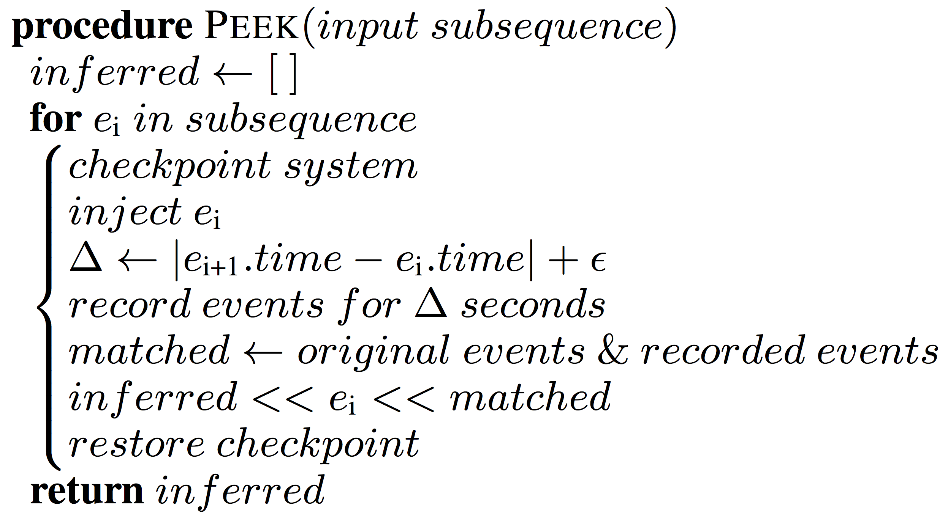
Solution: Peek ahead

Slide 25
Pruning Alters Internal Events!
Prune Earlier Input..
Crash
Master
Ping
Pong
Ping
Backup
Master
Notify
Notify
ACK
Blackhole persists!
Switch
Link Failure
Notes:
Is Rob Vaterlaus in the room?

Slide 26
Pruning Alters Internal Events!
Unexpected Events Appear
Crash
Master
Ping
Pong
Ping
Backup
Master
Notify
Notify
ACK
Ping
Pong
Blackhole persists!
Switch
Link Failure
Notes:
Is Rob Vaterlaus in the room?

Slide 27
Dealing with unexpected events
Heuristic:
Allow unexpected events through

Slide 28
Coping With Non-Determinism
Replay multiple times per subsequence
Probability of not finding bug defined by:
Optionally override gettimeofday(), multiplex sockets, interpose on logging statements
Notes:
Hint: this is very small
Other tricks:
- multiplexed sockets
- override gettimeofday and rand
- interpose on logging library
- interpose on intra-controller messages

Slide 29
It Works!

Slide 30
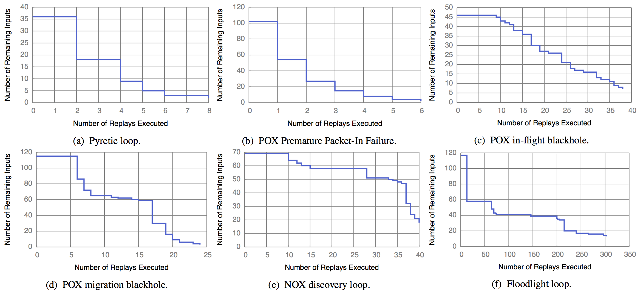
It Works!

Slide 31
Summary
Goal: isolate minimal causal sequences
We built a real system (21K+ lines of Python) that works on real controllers (Floodlight, NOX, POX, Frenetic, ONOS) including one proprietary controller
Check us out:
ucb-sts.github.com/sts/

Slide 32
References
[1] V. Soundararajan and K. Govil. Challenges in building scalable virtualized datacenter management. SIGOPS Operating Systems Review ’10.
[2] A. Greenberg, J. R. Hamilton, N. Jain, S. Kandula, C. Kim, P. Lahiri, D. A. Maltz, P. Patel, and S. Sengupta. VL2: a scalable and flexible data center network, Sec. 3.4. SIGCOMM ’09.

Slide 33
Backup

Slide 34
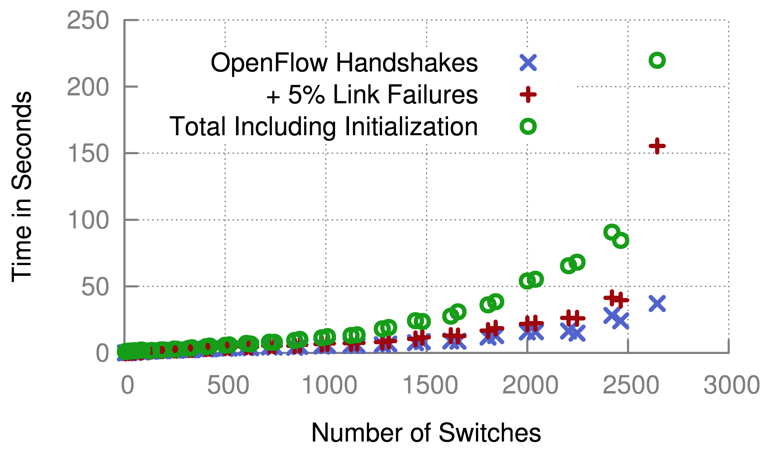
Scalability

Slide 35

Complexity
Best Case | Worst Case
Delta Debugging: (log n) replays Each replay: O(n) events Total: (nlog n) | Delta Debugging: O(n) replays Each replay: O(n) events Total: O(n²)
Notes:
Key issue is not complexity, it’s running in parallel overnight. Reduce dev time at all costs!
Optimizations:
- can be parallelized
Can take periodic snapshots
Causal annotations

Slide 36
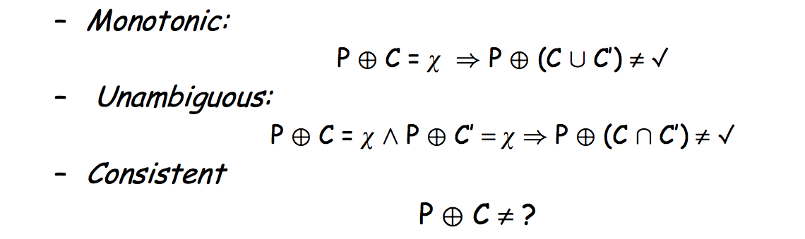
Assumptions of Delta Debugging

Slide 37
Coping With Non-determinism
Results for synthetic multithreading bug in Floodlight

Slide 38
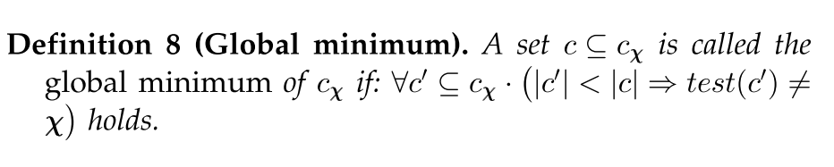
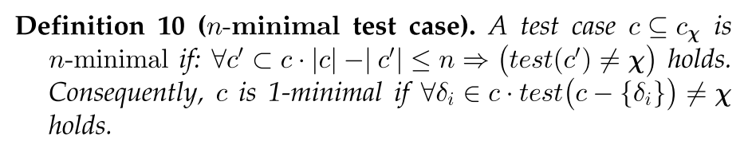
Local vs. Global Minimality

Slide 39
Forensic Analysis of Production Logs
Logs need to capture causality: Lamport Clocks or accurate NTP
Need clear mapping between input/internal events and simulated events
Must remove redundantly logged events
Might employ causally consistent snapshots to cope with length of logs

Slide 40
Related Work
Delta Debugging
Program Flow Analysis
Instrumentation (Tracing)
Bug Detection (Invariant Checking, Model Checking)
Replay
Root Cause Analysis

Slide 41
Instrumentation Complexity
Code to override gettimeofday(), interpose on logging statements, and multiplex sockets:
415 LOC for POX (Python)
722 LOC for Floodlight (Java)

Slide 42
Future Work
Many improvements:
Parallelize delta debugging
Smarter delta debugging time splits
Apply program flow analysis to further prune
Compress time (override gettimeofday)
Apply to other distributed systems

